Slide 1
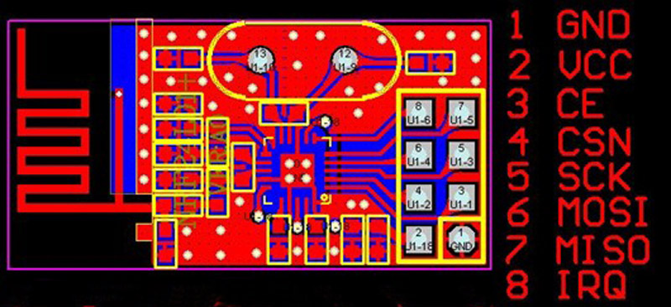
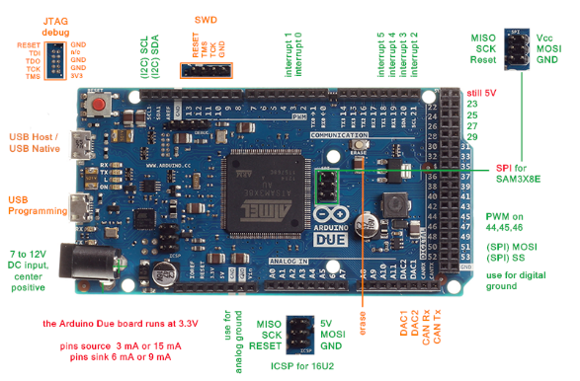
Connect to 3.3 V!
NOTE: the above view is looking
down on the RF24 from the top
with pins pointing away.

